Slide 1

Linux commands

Slide 2
grep
Command | Description
grep -i | Returns the results for case insensitive strings
grep -n | Returns the matching strings along with their line number
grep -v | Returns the result of lines not matching the search string
grep -c | Returns the number of lines in which the results matched the search string
This command searches for a particular string/ word in a text file. This is similar to “Ctrl+F” but executed via a CLI.
grep <flag or element_to_search> {filename}

Slide 3
sort
Command | Description
sort -r | the flag returns the results in reverse order;
sort -f | the flag does case insensitive sorting
sort -n | the flag returns the results as per numerical order
This command sorts the results of a search either alphabetically or numerically. It also sorts files, file contents, and directories.

Slide 4

chown
Different users in the operating system have ownership and permission to ensure that the files are secure and put restrictions on who can modify the contents of the files. In Linux there are different users who use the system:
Each user has some properties associated with them, such as a user ID and a home directory. We can add users into a group to make the process of managing users easier.
A group can have zero or more users. A specified user is associated with a “default group”. It can also be a member of other groups on the system as well.

Slide 5
Ownership and Permissions
To protect and secure files and directory in Linux we use permissions to control what a user can do with a file or directory. Linux uses three types of permissions:
Read: This permission allows the user to read files and in directories, it lets the user read directories and subdirectories stores in it.
Write: This permission allows a user to modify and delete a file. Also, it allows a user to modify its contents (create, delete and rename files in it) for the directories. Unless you give the execute permission to directories, changes does not affect them.
Execute: The write permission on a file executes the file. For example, if we have a file named sh so unless we don’t give it execute permission it won’t run.

Slide 6

Types of file Permissions:
User: This type of file permission affects the owner of the file.
Group: This type of file permission affects the group which owns the file. Instead of the group permissions, the user permissions will apply if the owner user is in this group.
Other: This type of file permission affects all other users on the system.

Slide 7
chown owner_name file_name
chown amandeep file1.txt
sudo chown root file1.txt

Slide 8
chmod
This command is used to change the access permissions of files and directories.
Syntax:
chmod <permissions of user,group,others> {filename}
4 – read permission
2 – write permission
1 – execute permission
0 – no permission

Slide 9
lsof
While working in Linux/Unix system there might be several file and folder which are being used, some of them would be visible and some not. lsof command stands for List Of Open File. This command provides a list of files that are opened. Basically, it gives the information to find out the files which are opened by which process. With one go it lists out all open files in the output console.

Slide 10
$lsof [option][user name]
lsof -u username

Slide 11

ifconfig(interface configuration) command is used to configure the kernel-resident network interfaces. It is used at the boot time to set up the interfaces as necessary. After that, it is usually used when needed during debugging or when you need system tuning. Also, this command is used to assign the IP address and netmask to an interface or to enable or disable a given interface.

Slide 12
-a : This option is used to display all the interfaces available, even if they are down.
Syntax:
ifconfig -a

Slide 13
-s : Display a short list, instead of details.
Syntax:
ifconfig -s

Slide 14
id command in Linux is used to find out user and group names and numeric ID’s (UID or group ID) of the current user or any other user in the server. This command is useful to find out the following information as listed below:
User name and real user id.
Find out the specific Users UID.
Show the UID and all groups associated with a user.
List out all the groups a user belongs to.
Display security context of the current user.

Slide 15
id [OPTION]… [USER]
Options:
-g: Print only the effective group id.
-G: Print all Group ID’s.
-n: Prints name instead of a number.
-r: Prints real ID instead of numbers.
-u: Prints only the effective user ID.
–help: Display help messages and exit.
–version: Display the version information and exit.

Slide 16
cut
Cut command is used for extracting a portion of a file using columns and delimiters. If you want to list everything in a selected column, use the “-c” flag with cut command. For example, lets select the first two columns from our demo1.txt file.
cut -c1-2 demo1.txt

Slide 17
diff
diff command is used to find the difference between two files. This command analyses the files and prints the lines which are not similar. Lets say we have two files test and test1. you can find the difference between the two files using the following command.
Syntax –
diff test.txt test1.txt
Lines preceded by a < are lines from the first file.
Lines preceded by > are lines from the second file.

Slide 18
history
history command is used to view the previously executed command. This feature was not available in the Bourne shell. Bash and Korn support this feature in which every command executed is treated as the event and is associated with an event number using which they can be recalled and changed if required. These commands are saved in a history file. In Bash shell history command shows the whole list of the command.

Slide 19
free
In LINUX, there exists a command-line utility for this and that is free command which displays the total amount of free space available along with the amount of memory used and swap memory in the system, and also the buffers used by the kernel.
This is pretty much what free command does for you. Syntax:
$free [OPTION]

Slide 20
Free
When no option is used then free command produces the columnar output as shown above where column:
total displays the total installed memory (MemTotal and SwapTotal e present in /proc/meminfo).
used displays the used memory.
free displays the unused memory.
shared displays the memory used by tmpfs(Shmen epresent in /proc/meminfo and displays zero in case not available).
buffers displays the memory used by kernel buffers.
cache displays the memory used by the page cache and slabs(Cached and Slab available in /proc/meminfo).
buffers/cache displays the sum of buffers and cache.

Slide 21
Options for free command
-b, – -bytes :It displays the memory in bytes.
-k, – -kilo :It displays the amount of memory in kilobytes(default).
-m, – -mega :It displays the amount of memory in megabytes.
-g, – -giga :It displays the amount of memory in gigabytes

Slide 22
ssh-keygen
Use the ssh-keygen command to generate a public/private authentication key pair. Authentication keys allow a user to connect to a remote system without supplying a password. Keys must be generated for each user separately. If you generate key pairs as the root user, only the root can use the keys.
The following example creates the public and private parts of an RSA key:
ssh-keygen -t rsa

Slide 23
Use the –t option to specify the type of key to create. Possible values are “rsa1” for protocol version 1, and “dsa“, “ecdsa“, or “rsa” for protocol version 2.
You have the option of specifying a passphrase to encrypt the private part of the key. If you encrypt your personal key, you must supply the passphrase each time you use the key. This prevents an attacker, who has access to your private key and can impersonate you and access all the computers you have access to, from being able to do so. The attacker still needs to supply the passphrase.

Slide 24
ip
ip command in Linux is present in the net-tools which is used for performing several network administration tasks.This command is used to show or manipulate routing, devices, and tunnels. This command is used to perform several tasks like assigning an address to a network interface or configuring network interface parameters. It can perform several other tasks like configuring and modifying the default and static routing, setting up a tunnel over IP, listing IP addresses and property information, modifying the status of the interface, assigning, deleting and setting up IP addresses and routes.

Slide 25
ip [ OPTIONS ] OBJECT { COMMAND | help }
ip address

Slide 26
nslookup
Nslookup (stands for “Name Server Lookup”) is a useful command for getting information from DNS server. It is a network administration tool for querying the Domain Name System (DNS) to obtain domain name or IP address mapping or any other specific DNS record. It is also used to troubleshoot DNS related problems.
Syntax:
nslookup [option]
nslookup google.com

Slide 27
curl
curl is a command-line tool to transfer data to or from a server, using any of the supported protocols (HTTP, FTP, IMAP, POP3, SCP, SFTP, SMTP, TFTP, TELNET, LDAP or FILE). This command is powered by Libcurl. This tool is preferred for automation since it is designed to work without user interaction. It can transfer multiple file at once.

Slide 28
curl -I -s https://opensource.com

Slide 29
DF command
The df command (short for disk free) is used to display the total and available disk space for the
filesystems on your system. It is often used with
the -Th options for displaying the output in a human-readable format.

Slide 30
du Command
The du command (short for disk usage) displays the file space usage in a directory.
It tracks space occupied by files and directories.
The like the df command, du is used with the -h option to display output in a human-readable format.

Slide 31
curl [options] [URL...]
The most basic uses of curl is typing the command followed by the URL.
curl https://www.python.org
-o : saves the downloaded file on the local machine with the name provided in the parameters.
Syntax:
curl -o [file_name] [URL...]

Slide 32
tr
The tr command in UNIX is a command-line utility for translating or deleting characters. It supports a range of transformations including uppercase to lowercase, squeezing repeating characters, deleting specific characters and basic find and replace. It can be used with UNIX pipes to support more complex translation. tr stands for translate.
Syntax:
$ tr [flag] SET1 [SET2]
Options
-c : complements the set of characters in string.i.e., operations apply to characters not in the given set -d : delete characters in the first set from the output. -s : replaces repeated characters listed in the set1 with single occurrence -t : truncates set1

Slide 33
Tail:
The tail command is complementary to the head command. As the name suggests, this Linux command is used to print the last N number of data of the given input.
By default, this command prints the last 10 lines of the specified file or data. In case you input more than one filename, you will get data from each file preceded by its file name.
tail [OPTION]… [FILE]…

Slide 34
Echo Command
In Linux, the echo command can be used for displaying a line of string/text that is passed as the arguments. This command is a built-in that is mostly and widely used in various batch files and shell scripts to outcome status test to a file and screen.
echo [option] [string]
echo -e "World \bis \bBeautiful"
\b: This option is used for removing every space among the text/string.

Slide 35
\n: This option is used for creating a new line and this new line will be created from where it's used.
Example:
echo -e "World \nis \nBeautiful"
\t: This option is used for creating the horizontal tab spaces.
echo -e "World \tis \tBeautiful"

Slide 36
\r: This option is used for carriage return along with '-e' backspace interpretor to have described carriage return in the result.
echo -e "World \ris Beautiful"
\v: This option is used for creating the vertical tab spaces.
echo -e "World \vis \vBeautiful"

Slide 37
\a: This option is used for alert return along with '-e' backspace interpretor to add sound alert.
echo -e "\aWorld is Beautiful"

Slide 38
echo *: This option is used for printing every folder or file. It is the same as the ls command in Linux.
Print specific types of files: For example, if we wish to print every '.c' file, we can apply the below command:
echo *.txt

Slide 39
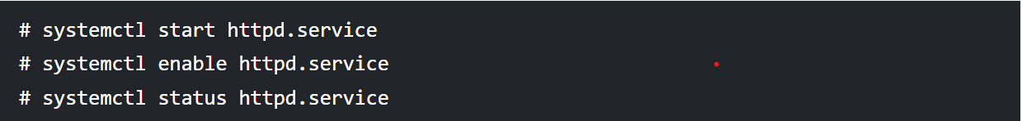
Systemctl Command
Systemctl command is a systemd management tool that is used to manage services, check running statuses, start and enable services and work with the configuration files.

Slide 40
Relational Operators
Relational Operators: Relational operators are those operators which define the relation between two operands. They give either true or false depending upon the relation. They are of 6 types:
‘==’ Operator: Double equal to operator compares the two operands. Its returns true is they are equal otherwise returns false.
‘!=’ Operator: Not Equal to operator return true if the two operands are not equal otherwise it returns false.
‘<‘ Operator: Less than operator returns true if first operand is less than second operand otherwise returns false.
‘<=’ Operator: Less than or equal to operator returns true if first operand is less than or equal to second operand otherwise returns false
‘>’ Operator: Greater than operator return true if the first operand is greater than the second operand otherwise return false.
‘>=’ Operator: Greater than or equal to operator returns true if first operand is greater than or equal to second operand otherwise returns false

Slide 41
Logical Operators : They are also known as boolean operators. These are used to perform logical operations. They are of 3 types:
Logical AND (&&): This is a binary operator, which returns true if both the operands are true otherwise returns false.
Logical OR (||): This is a binary operator, which returns true is either of the operand is true or both the operands are true and return false if none of then is false.
Not Equal to (!): This is a unary operator which returns true if the operand is false and returns false if the operand is true.

Slide 42
Bitwise Operators: A bitwise operator is an operator used to perform bitwise operations on bit patterns. They are of 6 types:
Bitwise And (&): Bitwise & operator performs binary AND operation bit by bit on the operands.
Bitwise OR (|): Bitwise | operator performs binary OR operation bit by bit on the operands.
Bitwise XOR (^): Bitwise ^ operator performs binary XOR operation bit by bit on the operands.
Bitwise complement (~): Bitwise ~ operator performs binary NOT operation bit by bit on the operand.
Left Shift (<<): This operator shifts the bits of the left operand to left by number of times specified by right operand.
Right Shift (>>): This operator shifts the bits of the left operand to right by number of times specified by right operand.

Slide 43
File test Operators
File Test Operator: These operators are used to test a particular property of a file.
-b operator: This operator check whether a file is a block special file or not. It returns true if the file is a block special file otherwise false.
-c operator: This operator checks whether a file is a character special file or not. It returns true if it is a character special file otherwise false.
-d operator: This operator checks if the given directory exists or not. If it exists then operators returns true otherwise false.
-e operator: This operator checks whether the given file exists or not. If it exits this operator returns true otherwise false.
-r operator: This operator checks whether the given file has read access or not. If it has read access then it returns true otherwise false.
-w operator: This operator check whether the given file has write access or not. If it has write then it returns true otherwise false.
-x operator: This operator check whether the given file has execute access or not. If it has execute access then it returns true otherwise false.
-s operator: This operator checks the size of the given file. If the size of given file is greater than 0 then it returns true otherwise it is false.

Slide 44
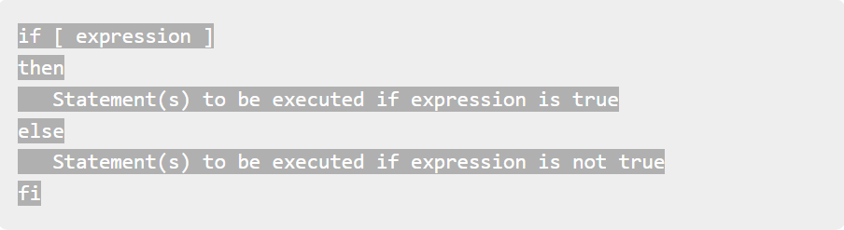
The if...else...fi statement

Slide 45
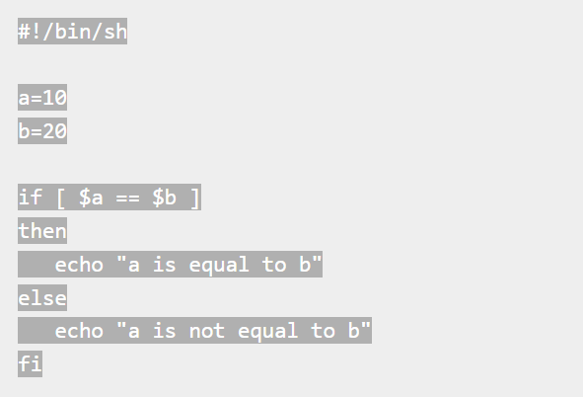

Slide 46
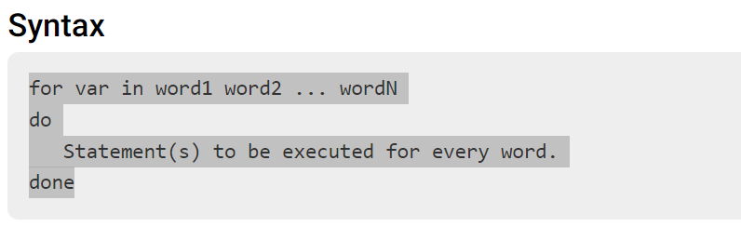
Iterative Statements:
The for loop operates on lists of items. It repeats a set of commands for every item in a list.

Slide 47
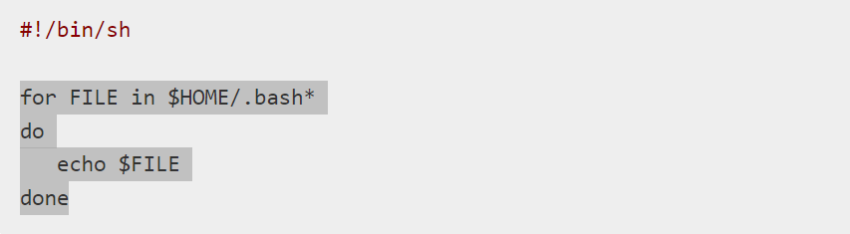
for FILE in $HOME/.bash* do echo $FILE done
display all the files starting with .bash and available in your home.

Slide 48
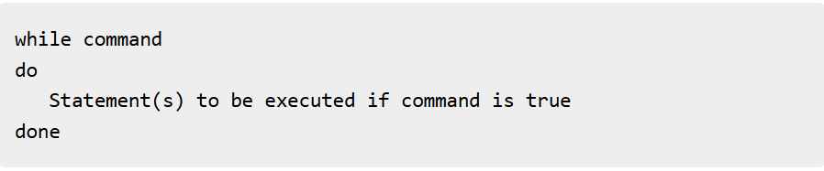
While loop

Slide 49
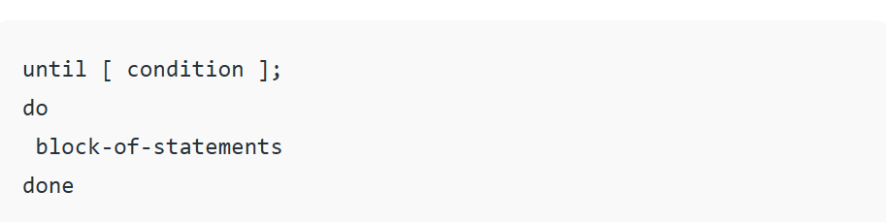
Until loop is used to iterate over a block of commands until the required condition is false.

Slide 50
Case
The basic syntax of the case...esac statement is to give an expression to evaluate and to execute several different statements based on the value of the expression.

Slide 51
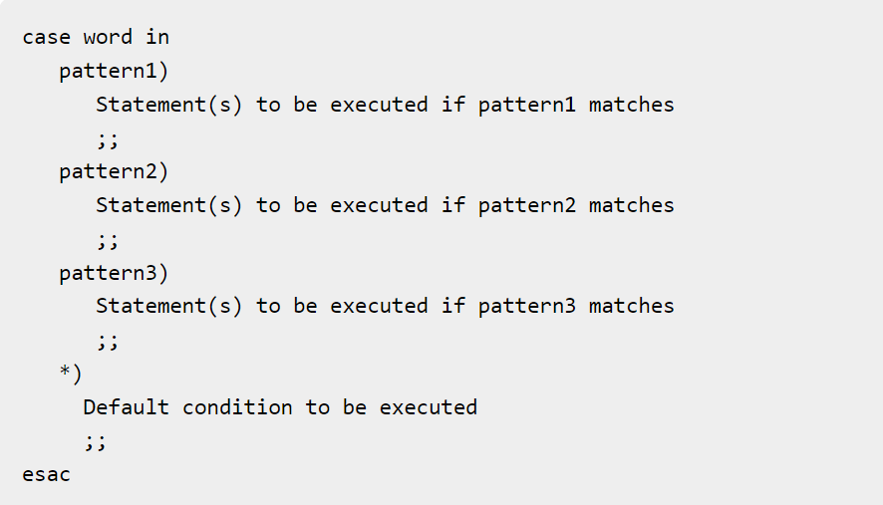

Slide 52
String Manipulation
String Manipulation is defined as performing several operations on a string resulting change in its contents. In Shell Scripting, this can be done in two ways: pure bash string manipulation, and string manipulation via external commands.

Slide 53
Assigning content to a variable and printing its content:
VariableName='value'
echo $VariableName
or
VariableName="value"
echo ${VariableName}
or
VariableName=value
echo "$VariableName

Slide 54
To print length of string inside Bash Shell
variableName=value
echo ${#variablename}

Slide 55
Concatenate strings inside Bash Shell using variables
listing the strings together concatenates the string. The resulting string so formed is a new string containing all the listed strings.
Syntax:
var=${var1}${var2}${var3}
or
var=$var1$var2$var3
or
var="$var1""$var2""$var3"

Slide 56
Get substring of String:
${string:position} --> returns a substring starting from $position till end
${string:position:length} --> returns a substring of $length characters starting from $position.

Slide 57
Substring matching
the shortest and longest possible match of a substring can be found and deleted from either front or back.
To delete the shortest substring match from front of $string:
${string#substring}
To delete the shortest substring match from back of $string:
${string%substring}
To delete the longest substring match from front of $string:
${string##substring}
To delete the shortest substring match from back of $string of $string:
${string%%substring}

Slide 58
Unix / Linux - Special Variables
the $ character represents the process ID number, or PID, of the current shell −
Echo $$
PID of the current shell
$0 The filename of the current script.

Slide 59
$n
These variables correspond to the arguments with which a script was invoked. Here n is a positive decimal number corresponding to the position of an argument (the first argument is $1, the second argument is $2, and so on).
$#
The number of arguments supplied to a script.

